Slide 1
Advanced Computational Methods in Geotechnical Engineering
Finite Difference Method (FDM)

Slide 2
FD Solution for 2D Flow
Flow of Water through soils is governed by Laplace’s equation:
where h is total head, kx & kz coefficients of permeability in x & z directions.
If the soil is isotropic kx = kz. Therefore:

Slide 3
FD Equation for 2D flow
Row L
Fig. 3.1: Partial grid of the flow domain
Row K

Slide 4
FD Equation for 2D flow

Slide 5
FD Equation for 2D Flow
Let α = k_{x}/k_{z} and Δx = Δz (square grid), then:
For isotropic condition α = 1 (k_{x} = k_{z}), hence:
(5.1)

Slide 6
FD Equation for 2D Flow
This equation shows that, in a square grid, the total head at every grid is the average of the total heads at the four adjacent grids.

Slide 7
Boundary Conditions
Flow can not cross impermeable boundaries, therefore, for a horizontal impermeable surface:
FDE for the boundary conditions is:
Neumann Boundary Condition

Slide 8
Boundary Conditions
Therefore:
Substituting into eqn. (5.1), we get:
(5.2)

Slide 9
Boundary Conditions
Various types of geometry of impermeable boundaries are encountered in practice. Following are three examples:
Impermeable
Impermeable
Impermeable
Impermeable
(a)
(b)
(c)

Slide 10
Boundary Conditions
The FDE for Figures (a) & (b) is:
The FDE for Figure (c) is:
(5.3)
(5.4)

Slide 11
Pore Water Pressure
Where h is total head, h_{p} is pressure head and z is elevation head.
Pore water pressure is obtained by:

Slide 12
Pore Water Pressure
Therefore:
Contours of potential heads can be drawn from the discrete values of h_{i,j}.
(5.5)

Slide 13
Velocity
The horizontal velocity of flow at any node is given by Darcy’s law:
Where i_{i,j} is the hydraulic gradient expressed as:

Slide 14
Velocity
Therefore:

Slide 15
Flow rate
The flow rate, q, is obtained by considering a vertical plane across the flow domain.
Let L be the top row and K be the bottom row of a vertical plane defined by column i (Fig. 5.1). Then the expression for q is:
(5.6)

Slide 16
Procedure for using FDM in 2D flow in soils
Step 1:
Divide the flow domain into a square grid.
Generally, finer grids give more accurate solution than coarser grids.
If the flow is symmetrical, you only need to consider one-half of the flow domain (below is an example).

Slide 17
Procedure …
Step 2:
Identify boundary conditions, example, impermeable boundaries (flow lines) and permeable boundaries (equipotential lines).
C
L
A
B
Equipotential boundary
2D
Flow Line
E
D
H₁
C
F
Flow Line
Impermeable

Slide 18
Procedure …
Step 3:
Determine the heads at the permeable or equipotential boundaries. For example, the heads along the equipotential boundary AB (figure above) is ΔH.
Therefore, all the nodes along this boundary will have a constant head of ΔH.
Because of symmetry, the head along nodes directly under the sheet pile wall (EF) is ΔH/2.

Slide 19
Procedure …
Step 4:
Apply the known heads to the corresponding nodes and assume reasonable initial values for the interior nodes.
Step 5:
Apply Eqn. (5.1) if the soil is isotropic to each node except:
at impermeable boundaries – eqn. (5.2)
at corners – eqn. (5.3) & (5.4)
at nodes where the heads are known

Slide 20
Procedure …
Step 6:
Repeat item 5 until the new value at the node differs from the old value by a small numerical tolerance for example 0.001 m.
Step 7:
Arbitrarily select a sequential set of nodes along a column of nodes and calculate the flow, q, using eqn. (5.6). It is best to calculate q’ = q for a unit permeability value to avoid too many decimal points in the calculations.

Slide 21
Procedure …
Step 8:
Repeat items 1 to 6, to find the flow distribution by replacing heads by flow q’. For example, the flow rate, calculated in item 7 is applied to all nodes along AC and CF.
Step 9:
Calculate the pore water pressure distribution using eqn. (5.5).

Slide 22
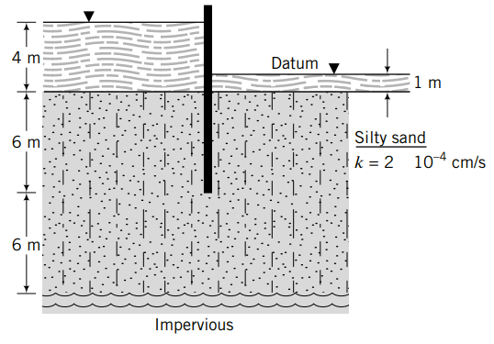
Example 1
Determine the flow under the sheet pile wall below and the pore water pressure distribution using FD.

Slide 23
Excel Solution
Step 1:
Divide the flow domain into a grid.
A
B
12 m
C
2 m×2m
grid
6 m
E
D
24 m

Slide 24
Excel Solution
Step 2:
Identify the boundary conditions.
Permeable boundaries: AB and CD are equipotential lines.
Impermeable boundaries: BC, AE and ED are flow lines.
Step 3:
Determine the heads at equipotential boundaries.
Along AB the head difference is 4 - 1 = 3 m.
Along CD the head difference is 3/2 = 1.5 m.

Slide 25
Excel Solution
Step 4:
Insert the heads at the nodes.
Set up the initial parameters in cells up to row 10.
In cells B12 to N12 enter head value of 3.
In cells N15 to N18 enter head value of 1.5.
Arbitrarily insert values in all other cells from B13 to M18, N13 & N14.

Slide 26
Excel Solution
Step 5:
Apply the appropriate equations.
On the impermeable boundaries – cells B13 to B18, C18 to M18, and N13 to N14, apply eqn. (5.2), (5.3) or (5.4), appropriately.
Apply eqn. (5.1) to all other cells except cells with known heads.

Slide 27
Excel Solution
Step 6:
Carry out the iterations.
In excel, go to File -> Options -> Formulas and check the 'Enable iterative calculation' checkbox. Set the maximum number of iterations and the required level of accuracy. Then click OK.
The calculation will be done automatically, if ‘Automatic’ option is selected. If ‘Manual’ option is selected, go to Formulas in the main menu and click the 'Calculate Now' button, located in the Calculation group.

Slide 28
Excel Solution
Step 7:
Calculate q.
Use eqn. (5.6) to calculate q’ for a unit value of permeability. In the spreadsheet for this example q’ is calculated in cell C 20 as:
The actual value of q is:

Slide 29
Excel Solution
Step 8:
Calculate the flow for each cell.
In cells B36 to B42, and C42 to N42, copy q’. The flow at the downstream end (cells N36 to N39) is zero.
Apply eqn. (5.2) to cells C36 to M41 and N40 to N41.
Apply eqn. (5.1) to all other cells except the cells with known values of q’. Carry out the iterations.

Slide 30
Excel Solution
Step 9:
Calculate the pore water pressure.
From the potential heads, you can calculate the pore water pressure using eqn. (5.5). A plot of the pore water pressure distribution is shown in the figure below.

Slide 31
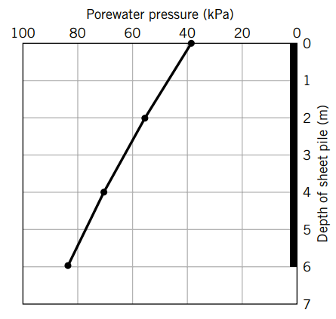
Excel Solution

Slide 32
Assignment 1
Determine the flow under the sheet pile wall (Fig. A3) and the pore water pressure distribution using the Finite Difference Method.
6 m
8 m
Sand
6 m
Impermeable

